Slide 1

Designing of IoT Solutions
IoT Physical Servers & cloud offering
Rashma.B.M
Department of Computer Science Engineering

Slide 2

Designing of IoT Solutions
IoT Physical Servers & cloud offering
Rashma.B.M
Department of Computer Science Engineering

Slide 3
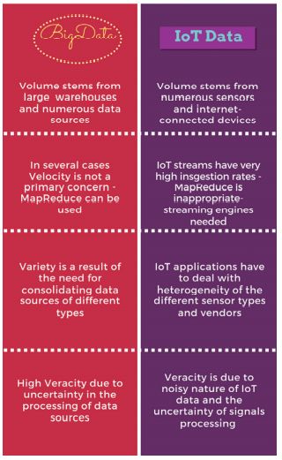
Designing IoT Solutions
Comparison

Slide 4
Designing IoT Solutions
Challenges of IoT Analytics Application
The heterogeneity of IoT data streams
• The varying data quality:
• The real-time nature of IoT datasets:
• The time and location dependencies of IoT streams:
• Privacy and security sensitivity:
• Data bias:

Slide 5
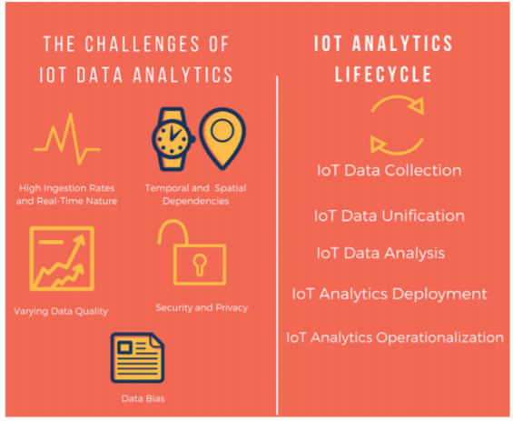
Designing IoT Solutions
Challenges of IoT Analytics Application

Slide 6
Designing IoT Solutions
IoT Analytics Lifecycle
IoT Analytics Lifecycle and
In particular:
• 1st Phase – IoT Data Collection
• 2nd Phase – IoT Data Analysis
• 3rd Phase – IoT Data Deployment, Operationalization and Reuse

Slide 7
Designing IoT Solutions
Data management and analysis disciplines
The tasks outlined in the above listed phases are supported by a range of data management and analysis disciplines, including:
• IoT middleware and interoperability technologies, which provide the means for collecting, structuring and unifying IoT data streams, thus addressing the variety and veracity challenges of IoT data.
• Statistics, which provide the theory for testing hypotheses about various insights stemming from IoT data.
• Machine learning, which enables the implementation of learning agents based on IoT data mining. Machine learning includes several heuristic techniques.
• Data mining and Knowledge Discovery, which combines theory and heuristics towards extracting knowledge. To this end, data cleaning, learning and visualization might be also employed.

Slide 8
Designing IoT Solutions
Data management and analysis disciplines
• Database management systems, including Relational Database Management Systems (RDMS), NoSQL databases, BigData databases (such as the HDFS (Hadoop Distributed File System), which provide the means for data persistence and management.
• Data streams management systems, which handle transient streams, including continuous queries, while being able to handle data with very high ingestion rates, including streams featuring unpredictable arrival times and characteristics. IoT streaming systems are also supported by scalable, distributed data management systems.

Slide 9
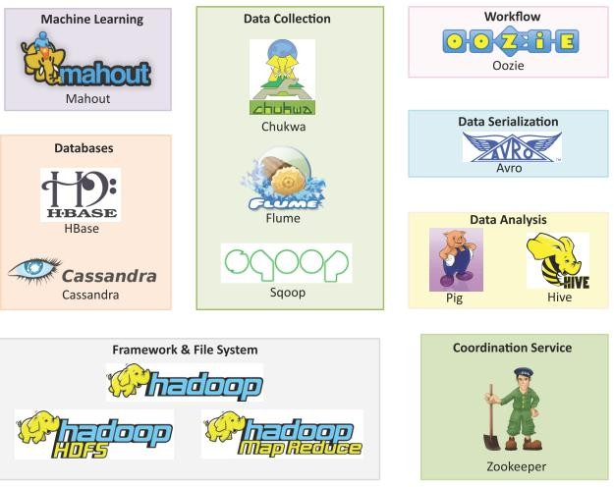
Designing IoT Solutions
Hadoop Ecosystem
Apache Hadoop is an open source framework for distributed batch processing of big data.
Hadoop Ecosystem includes:
Hadoop MapReduce
HDFS
YARN
HBase
Zookeeper
Pig
Hive
Mahout
Chukwa
Cassandra
Avro
Oozie
Flume
Sqoop
Book website: http://www.internet-of-things-book.com

Slide 10
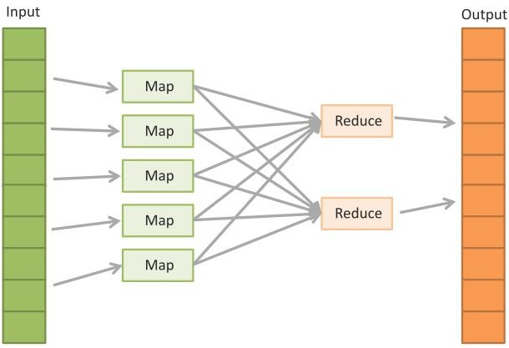
Designing IoT Solutions
MapReduce
Book website: http://www.internet-of-things-book.com

Slide 11
Designing IoT Solutions
MapReduce
MapReduce job consists of two phases:
Map: In the Map phase, data is read from a distributed file system and partitioned among a set of computing nodes in the cluster. The data is sent to the nodes as a set of key-value pairs. The Map tasks process the input records independently of each other and produce intermediate results as key-value pairs. The intermediate results are stored on the local disk of the node running the Map task.
Reduce: When all the Map tasks are completed, the Reduce phase begins in which the intermediate data with the same key is aggregated.
Optional Combine Task
An optional Combine task can be used to perform data aggregation on the intermediate data of the same key for the output of the mapper before transferring the output to the Reduce task.
Book website: http://www.internet-of-things-book.com

Slide 12
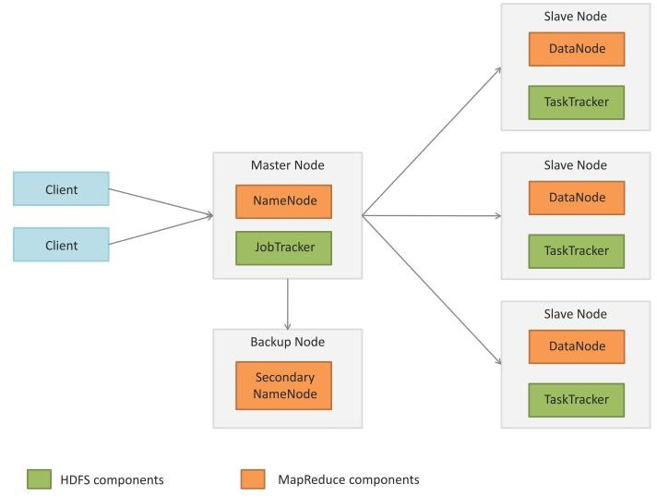
Designing IoT Solutions
Apache Hadoop
Book website: http://www.internet-of-things-book.com

Slide 13
THANK YOU
Rashma.B.M
Department of Computer Science Engineering
rashmabm@pes.edu

